Slide 1

Most Streamed Spotify Songs of 2024
What Makes a Hit?
Mani Atwal and Paul Ng

Slide 2
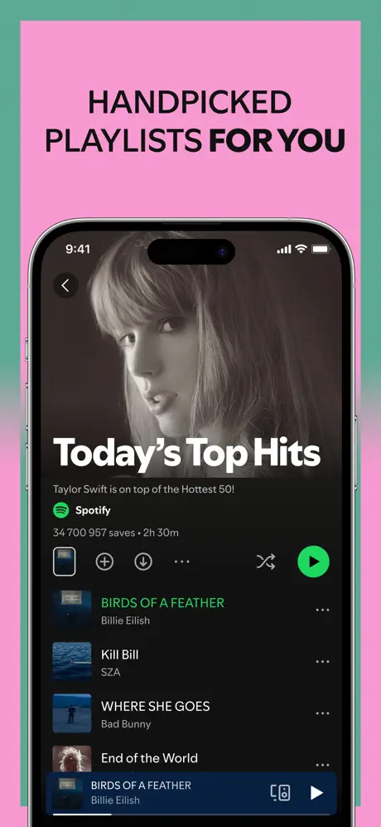
Goals
What makes songs top the charts?
How does YouTube matter?
How can Spotify boost discovery?
How can Spotify leverage these insights?

Slide 3
01
Streaming Distribution Patterns

Slide 4
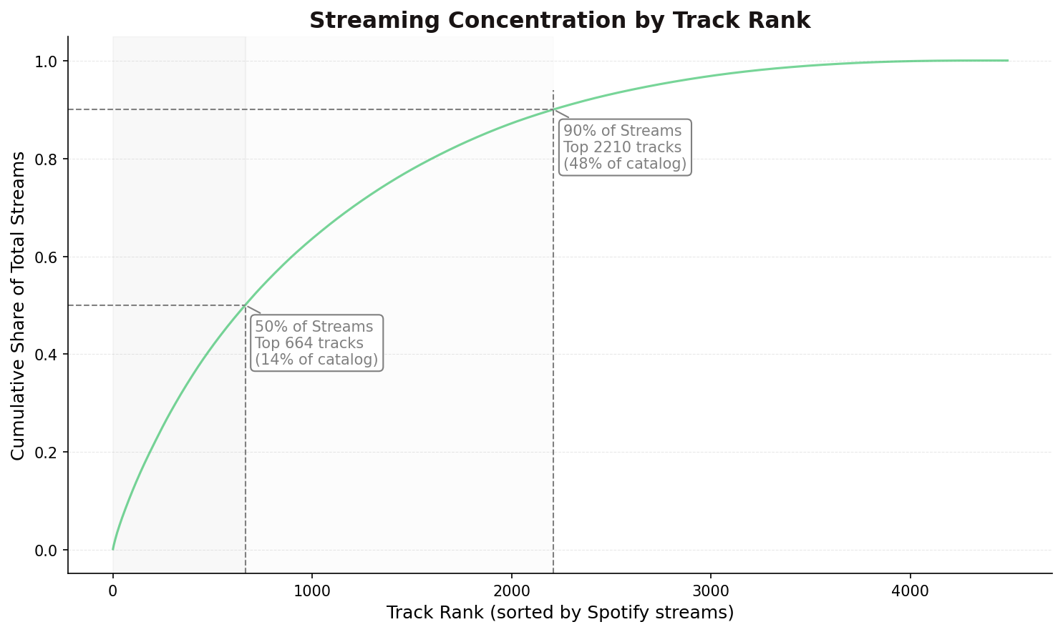
Streaming distribution is skewed toward a few high-performing tracks and artists
50% of all streams come from just 14% of tracks

Slide 5
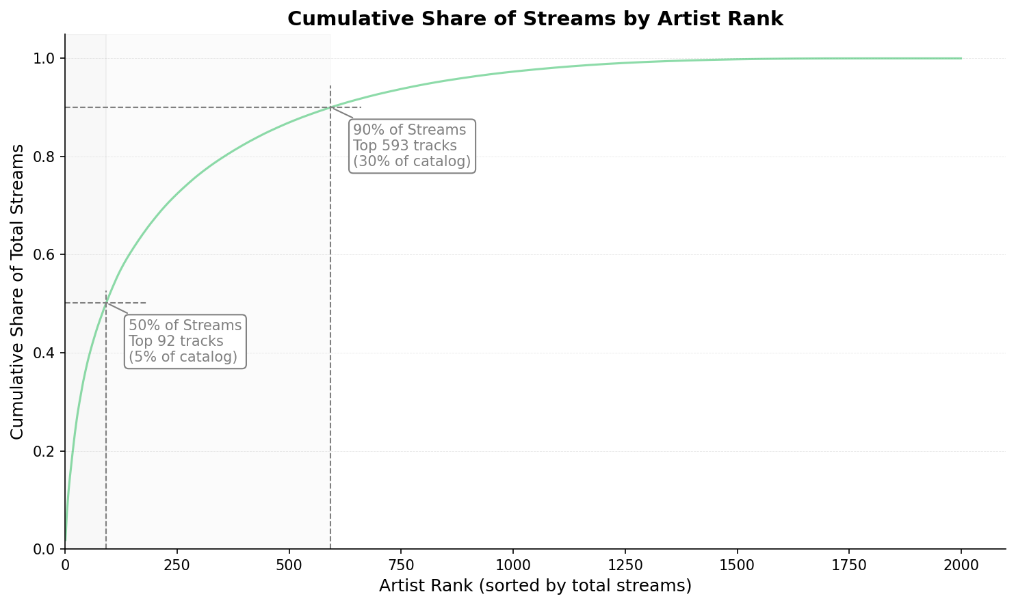
50% of streams come from top 5% of artists

Slide 6
02
Correlations and Stream-Drivers

Slide 7
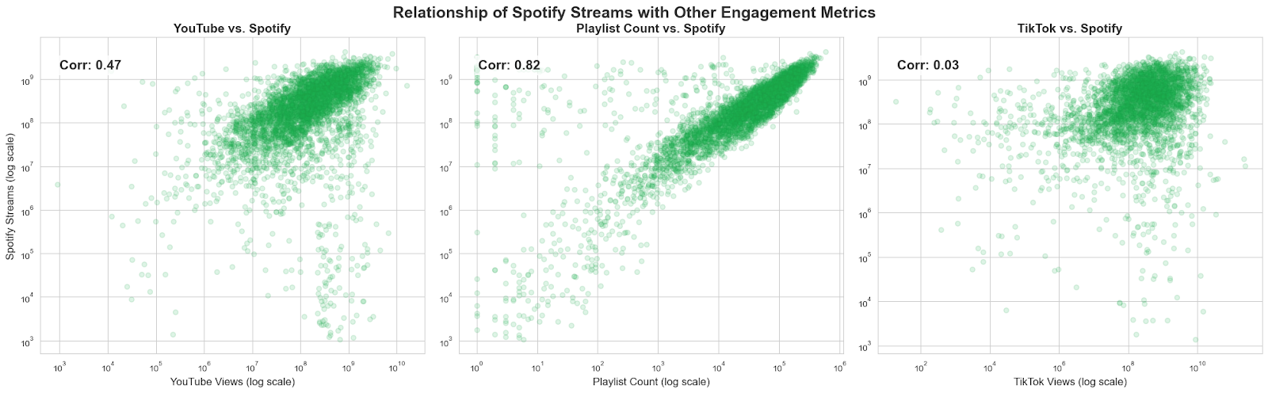
Video Visibility May Drive Spotify Streams
YouTube views and Spotify streams are moderately correlated
Videos can help boost music streams

Slide 8
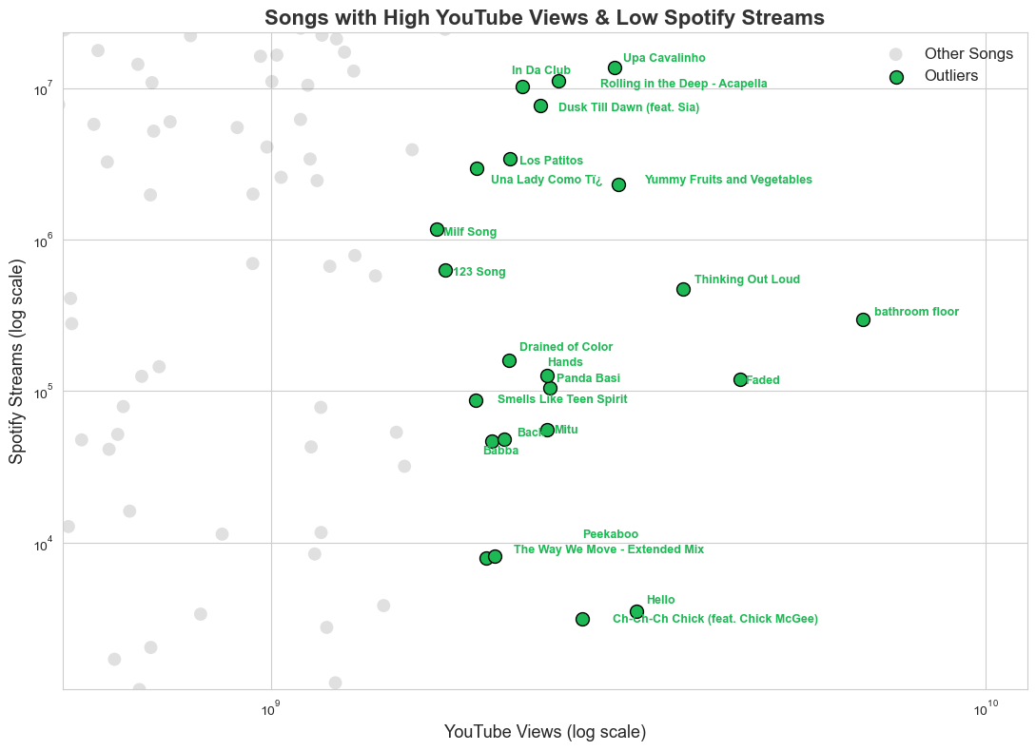
Some songs get many YouTube views but few Spotify streams
Shows missed chances to grow Spotify audience
Improve promotion and cross-platform strategy

Slide 9
Want More Streams? Get on More Playlists
Playlist count and Spotify streams are strongly correlated
Playlist placement is key for visibility and success

Slide 10
03
Title Word Impact on Streaming

Slide 11
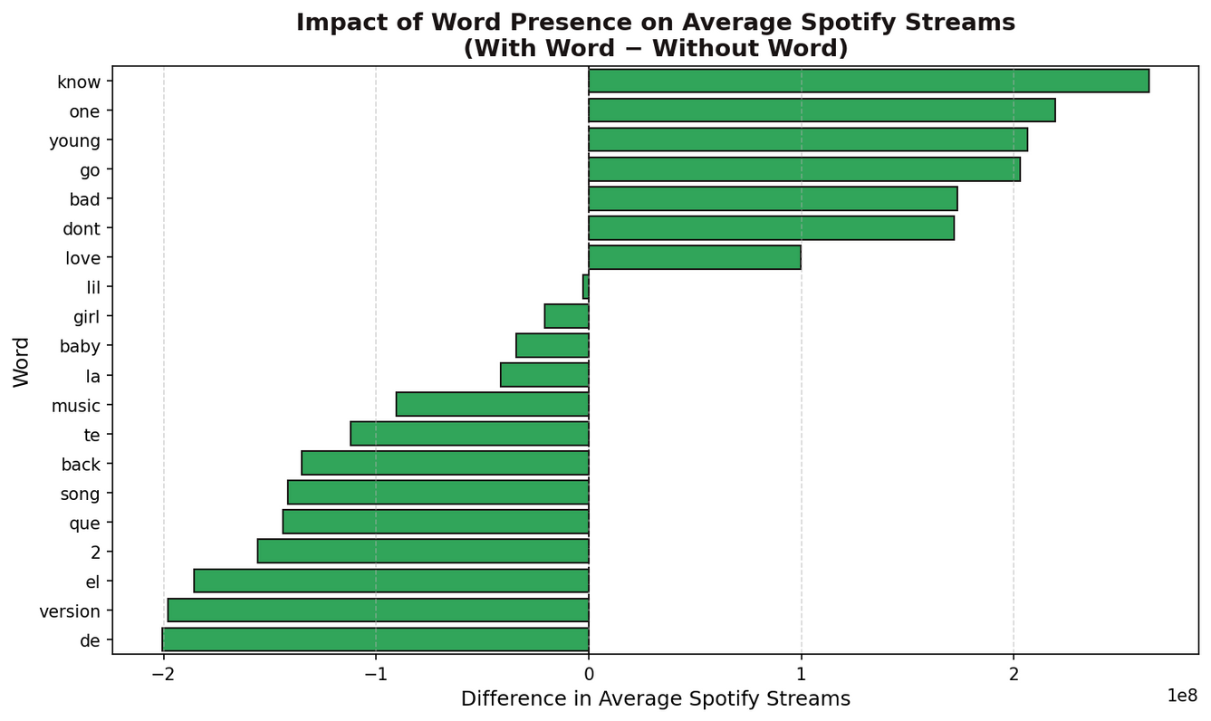
Words like “know,” “love,” and “young” link to much higher streams (+200M)
Words like “de,” “version,” and “song” link to much lower streams (-200M)
Test and use more “stream-friendly” words in titles and promotions

Slide 12
04
Key Insights & Strategic Takeaways

Slide 13
Key Insights | Strategic Takeaways
🎵 Top 14% of songs get 50% of streams | Focus resources on identifying and promoting breakout tracks early
📺 YouTube visibility correlates with Spotify success | Promote high-YouTube, low-Spotify tracks to drive crossover engagement
🎧 Playlists strongly predict stream counts | Prioritize strategic playlist placement across genres and moods
🔤 Certain title words (e.g. love, young) boost streams | A/B test track titles in marketing to favor high-performing language
🌟 Top 5% of artists generate 50% of streams | Strengthen artist loyalty via partnerships, exclusives, and promotions

Slide 14
Thank you!
CREDITS: This presentation template was created by Slidesgo, and includes icons, infographics & images by Freepik

